Slide 1
Environmental+Kiosk
Channel Overview

Slide 2
Overview
Environmental and Kiosk installations focus on taking experiences out of the home and into public space.
Well-executed installations provide an opportunity to increase brand awareness or educate through interactivity.
E+K generally push the boundaries of technology and provide the audience with an opportunity to experience something they could not do at home.
The most effective installations take a holistic approach – supporting other mediums and more traditional applications.
Notes:
Integrated experiences w/ more traditional channels provide the opportunity to measure the success of the endeavor.

Slide 3
What is the difference?
Both:
Public
Interactive
Take Home
Environmental means:
Social
Large
Experimental
Unique
Kiosk means:
Personal
Medium
Specific Task
Enclosed/Stationary
Notes:
Take Home component is critical for success.
If the experience ends right when the user leaves the installation then the message is lost.
Environmental means:
Public
Social (either multi-user or single-user/turn-based with an audience)
Large (size of a TV screen or larger)
Experimental, to a certain extent (often using technology that is new, hacked, or not generally marketed to consumers)
Unique (there is no “environmental platform”; every instance is a roll-your-own implementation)
Kiosk means:
Public space, mostly private experience (if social, it is limited to 1-2 users)
Narrowly-defined purpose (to view X, to browse X, to buy X, to learn X)
Medium (size of a TV screen or smaller)
Enclosed/stationary (and to a certain extent, permanent)

Slide 4
E+K Benefits
Brings patrons into the marketing efforts as active participants
Generates buzz from satisfied patrons and news outlets
Pushes the creative envelope beyond what is possible with traditional web/desktop/mobile environments

Slide 5
E+K Challenges
Expensive / ROI analysis
Weather: sun, heat, cold, humidity, precipitation
Vandalism / heavy usage
Extended uptime / memory management
Content moderation & monitoring
Placement
Notes:
Expensive to plan, design, develop, install, monitor
Often many new UX paradigms to solve – Natural User Interfaces
People are heavy handed – if not immediately responsive they will likely start hitting harder and harder
People are also assholes
Memory management is critical – these are systems that will be running for hours at a time, potentially 24/7. A small memory leak will completely kill the experience for users.
Anything that accepts user input must be moderated and sanitized.
Logs from the experience should also be monitored to ensure the experience is working as expected. Having someone onsite to monitor usage is also very important, although might not be as practical.
Placement – if it’s not in a good location, it will never work

Slide 6
Primary Challenge/Opportunity
Agencies that do E+K tend to own the process & experience from start-to-finish.
There is no “one-size fits all” solution or pre-made package that can be leveraged.
This opens up creative channels to do something unique and challenging.
This also creates risks in attempting something that may fail in the real world.
Notes:
Agencies that do this type of work have put a lot of effort into it and own the entire experience. This makes it hard for agencies that want to own one or a few components; they end up having to design their own from the ground up.

Slide 7
Locations
Environmental: place in areas with heavy foot traffic
Kiosk: place in visible “nooks”
Examples:
Vacant Storefronts
Airports
Malls
Museums
Lobbies
Notes:
An environmental installation is more likely to be “in the middle of the action”, such as the center of a showroom floor.
A kiosk installation would alternatively be placed along the perimeter.
Either way they need to be where there are people.

Slide 8
Common Technologies
Large display (LCD, Projection, 3D)
Touch (inc. multi-user)
Gestural
Voice & Aural
RFID / NFC
Bluetooth / WiFi
Internet Connectivity (Wired or Cellular)

Slide 9
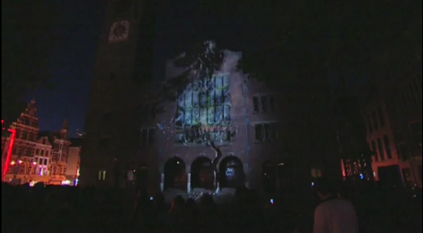
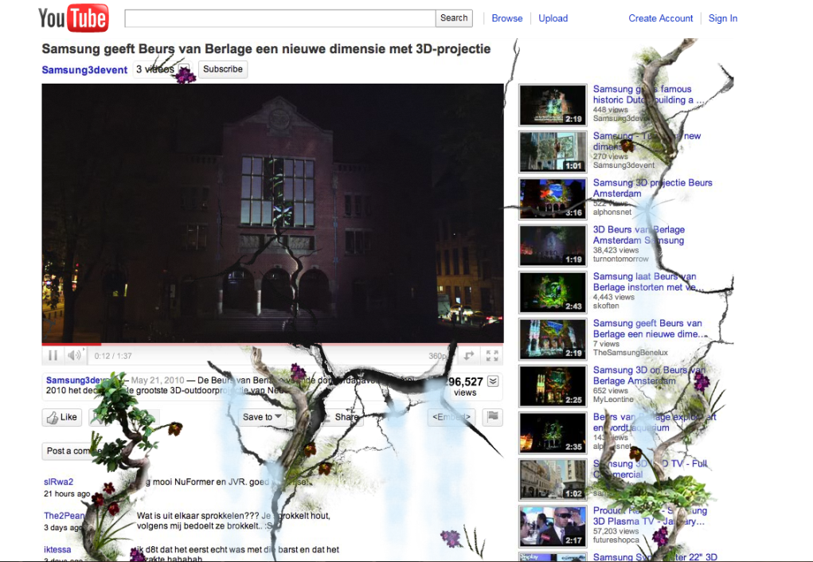
Example: Samsung Takeover (Muse)
3D Projection onto a public building
Coordinated web efforts for takeover Flash/HTML experience
Interactive web game & contest
Con: non-interactive, scheduled
Information: 1 2 3 4
Notes:
Coordinated web effort provided the ability for users to “take the experience home”.
Fact that it was just a presentation makes it a major failure – it is not interactive and it would only be played one or a few times versus an installation that users could always play with.

Slide 10
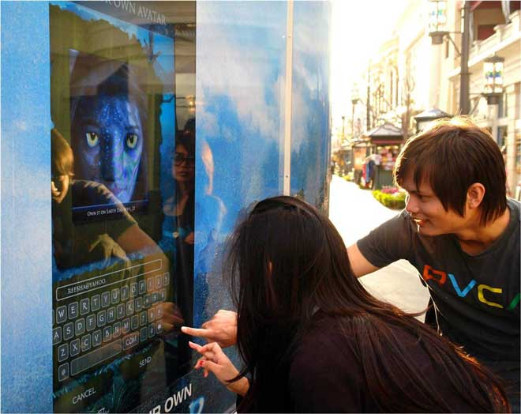
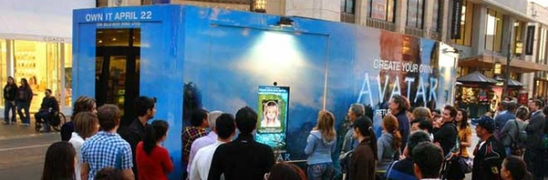
Example: Avatar Morph-Me (InWindow Outdoor)
Public terminals that let users take photos and turn into an Avatar character
Can print out the final result
Can email the image
Con: technology issues
Information: 1 2 3
Notes:
Installation was so popular that lines up to an hour formed.
Tech issues caused problems with the images getting mailed. As a result many people missed out on the “take home” experience.
No social component – might have been more useful to post your avatar to FB or Twitter.

Slide 11

Example: Library of Congress
Kiosks throughout the LoC let patrons experience exhibits that would otherwise be off-limits
Augments traditional museum exhibits
At-home web-based versions of the kiosks allow learning to continue after leaving the museum (myLOC.gov)
Information: 1 2

Slide 12
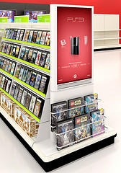
Example: Target Video Games Advisor (Schematic)
In-store display that presented customers with information about video games in the store
Provided more information than what was available on the game box
Can page store employee for help
Can email or SMS game information to self
Information: 1
Notes:
Interesting technical challenges: ADA accessibility
Benefit of having a client w/ physical presence

Slide 13
Hardware
Microsoft Surface2 / Samsung SUR40
MultiTouch Cell
iMotion Outdoor
TDC
ITS Enclosures
Planar Embedded
Microsoft Kinect
Additional touchscreen vendors

Slide 14
Major Players (Agencies)
inWindow Outdoor
Muse
Monster Media
SecondStory

Slide 15
Opportunities for BLITZ
Can carve out a niche to focus on
Can choose a set of technologies we are familiar with
Can use E+K as one component of a holistic solution
Can create a “package” to reuse for multiple clients, once groundwork has been laid
Entertainment clients (Halo, Saints Row, etc.) provide us an opportunity to extend the experience/message of their products
Clients with physical products (Alienware) provide us an opportunity to let users build/play with their products
Notes:
Package – many of Muse’s experiences build off the same idea/technologies, even similar sequences (water)
e.g. – Halo “terminals”
e.g. – Alienware system builder

Slide 16
Challenges for BLITZ
No prior experience in developing public installations
Any application will require tech undertaking to learn the utilized technologies
Many experiences will require significant UX investment

Slide 17
Wrap-Up
Think of how E+K can work to strengthen existing brands and messages
Must be one out of many integrated components
Take home message is critical – experience cannot end right when users step away
Focus on getting one thing perfect – one small mistake can ruin the entire experience

